Slide 1



APPLYING GoF DESIGN PATTERNS IN ONLINE SHOPPING SYSTEM
CSA1110 - OBJECT ORIENTED ANALYSIS AND DESIGN
PRESENTED BY:
TEJASWINI M (192411079)

Slide 2


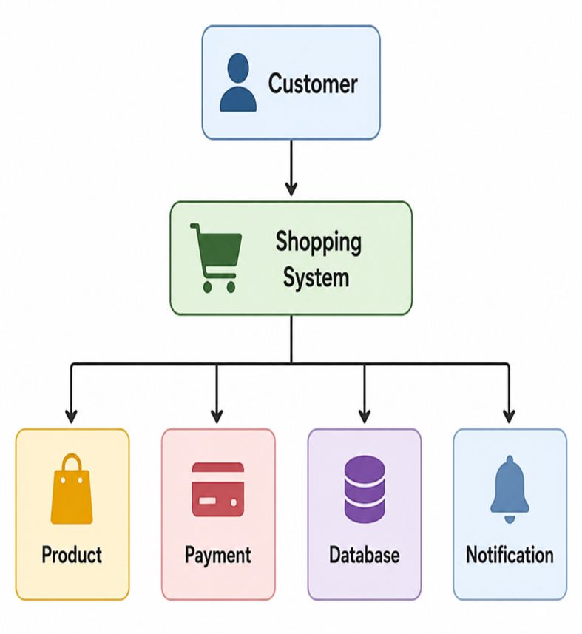
PROBLEM STATEMENT
EXISTING ONLINE SHOPPING SYSTEM
❌ Code Duplication
❌ Tight Coupling
❌ Difficult to Extend
❌ No Notification System
❌ Multiple Database Objects

Slide 3
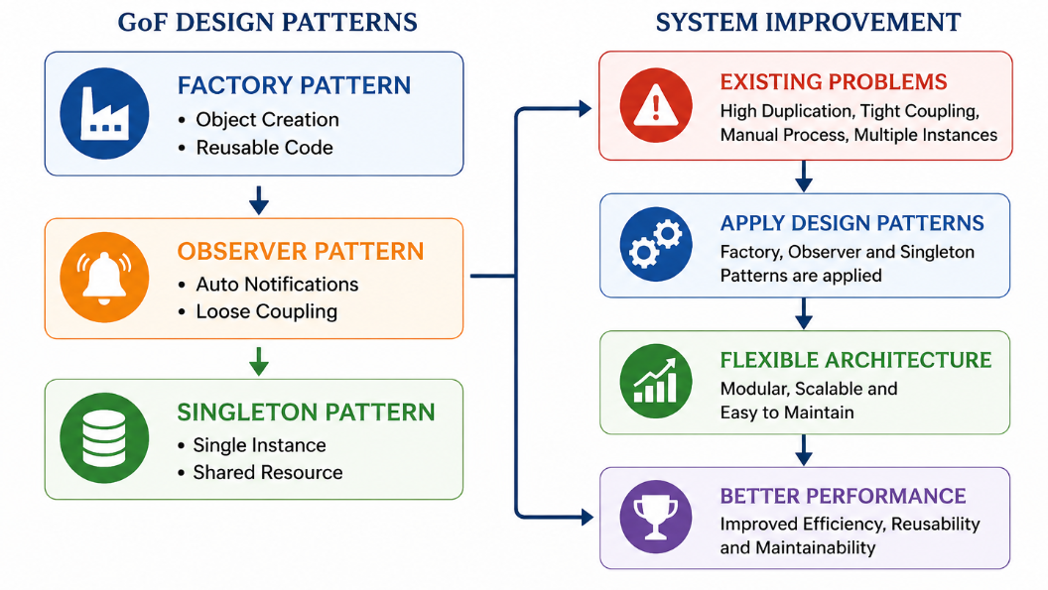
PROPOSED SOLUTION

Slide 4
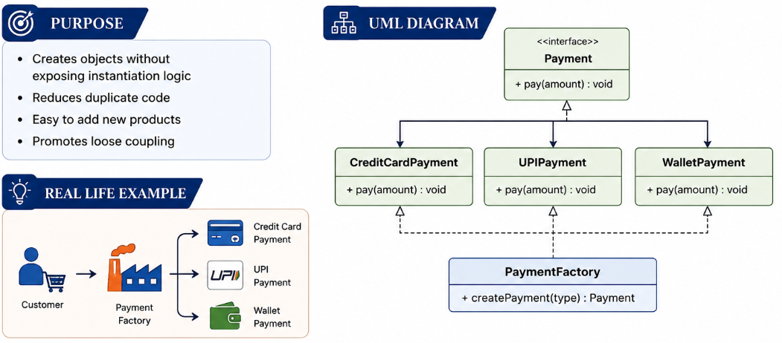
FACTORY PATTERN

Slide 5
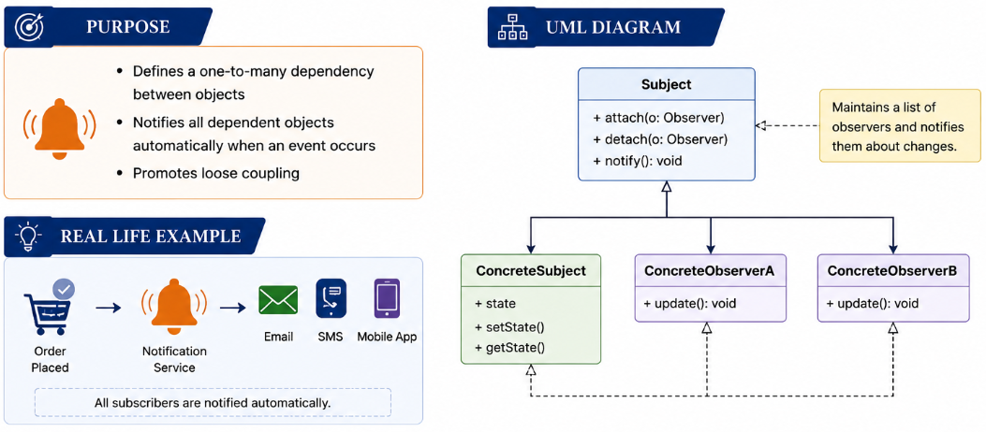
OBSERVER PATTERN

Slide 6
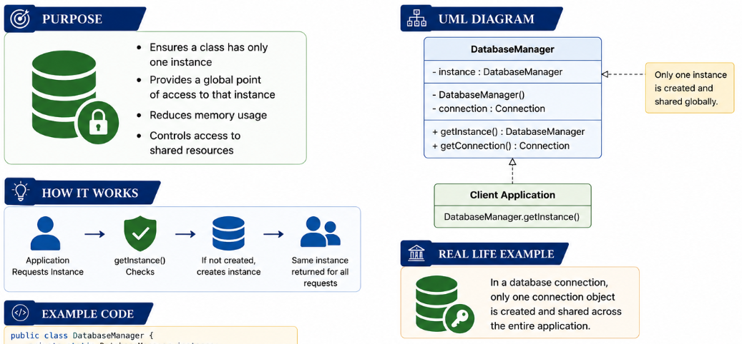

SINGLETON PATTERN

Slide 7
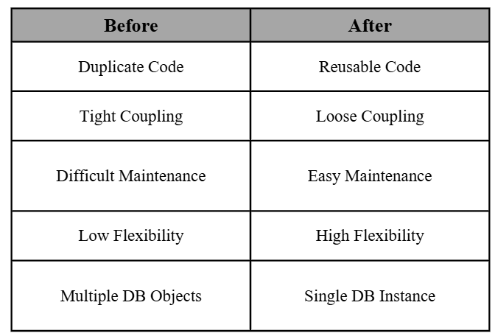
BEFORE VS AFTER

Slide 8
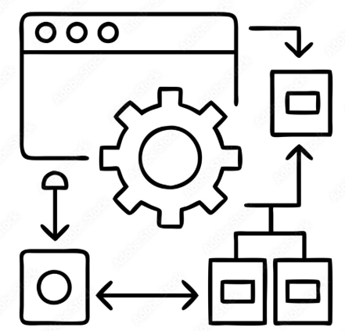
CONCLUSION
Design Patterns improve software quality by:
Reducing code duplication
Increasing flexibility
Supporting scalability
Improving maintainability
Promoting reusable code

